Slide 1
Workshop 5:Taking Action. Building a School-Wide Initiative

Slide 2
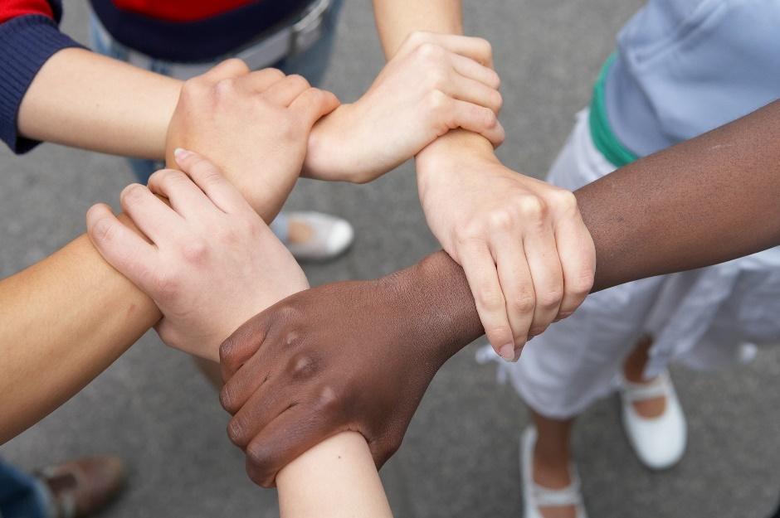
Community Commitments
Listening
Right to Pass
Appreciation
Confidentiality
Speak for Yourself
Right to “Ouch”

Slide 3
Key Concepts from Workshop 4
There are diverse approaches to conflict.
Cross-cultural communication and bridges to communication are key skills in inclusive leadership.
Allyship is an effective way of supporting those involved in exclusionary conflict and empowering others.

Slide 4
Design a Campaign
GOAL: to have an impact
TARGET: young people
HOW: unlimited resources

Slide 5
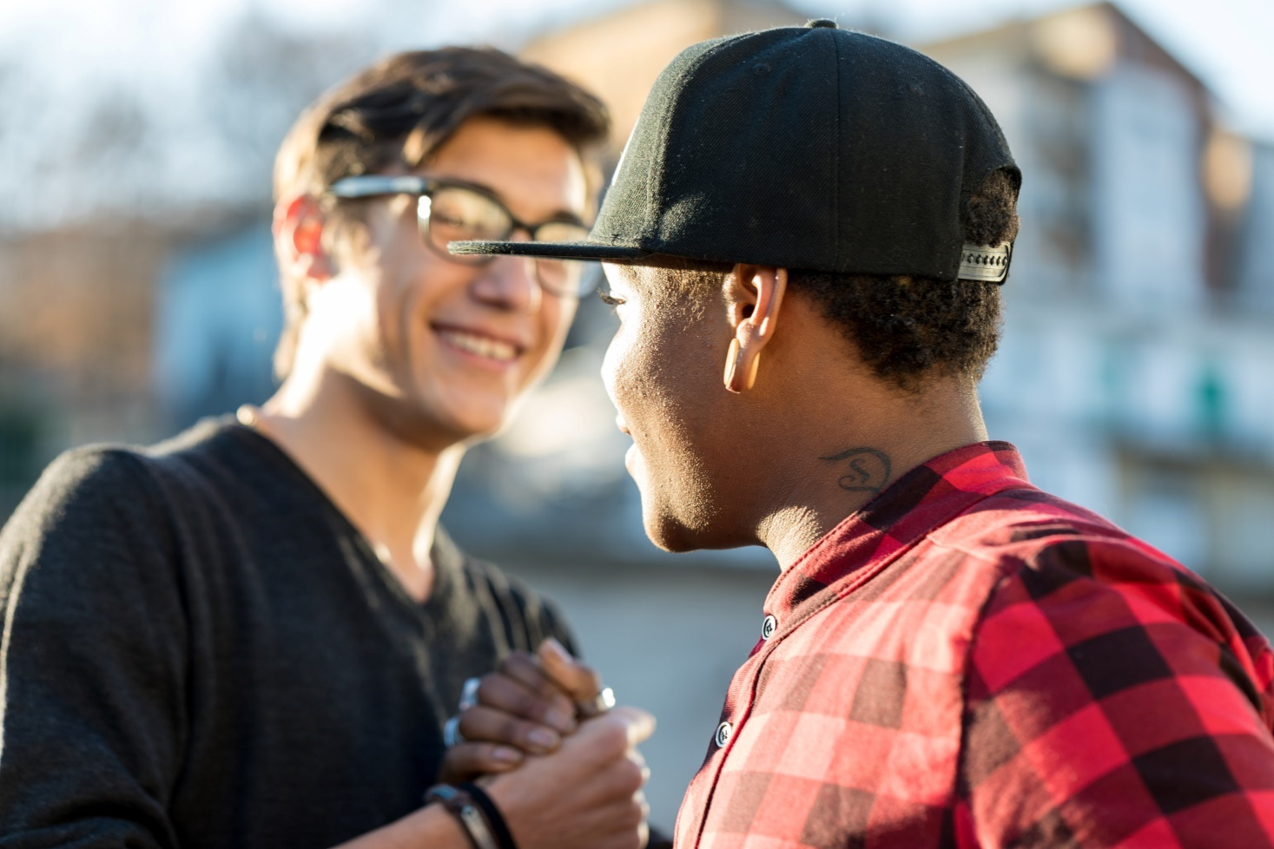
Calling-in vs. Calling-out

Slide 6
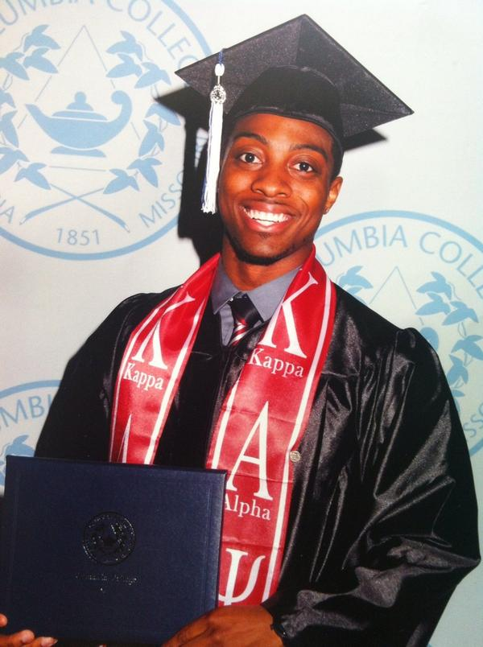
Calling-out: an example
“ #iftheygunnedmedown they’d say I was a thug”- Devin Griffin (Twitter; CBC news)

Slide 7
Calling-in: an example
“The letter is meant to help Asians start having conversations within their own communities about anti-black racism, and specifically, about the anti-black racism that Asians are complicit in,” said Ren Ito, a Japanese Canadian from Toronto and one of the organizers of the Canadian campaign.

Slide 8
See Different in Action
Workshop 1: Diversity and identity
Workshop 2: Exploring my power and privilege
Workshop 3: Prejudice, bias and discrimination: how to break the cycle
Workshop 4: Navigating the conflict zone and becoming an ally

Slide 9
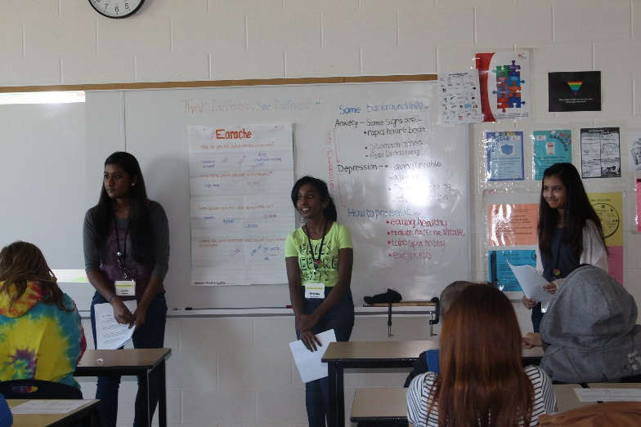
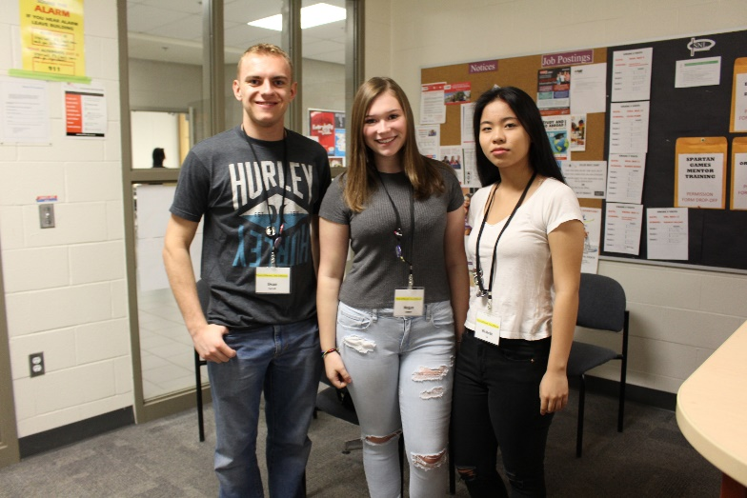
SWI: Stouffville S.S
Mental Health
30-min Gr.9 workshop
(to 13 classes)
Reach: 200

Slide 10
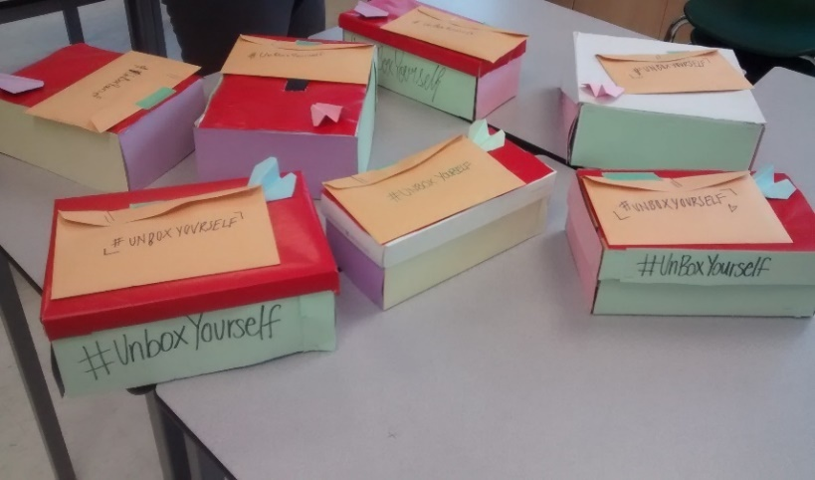
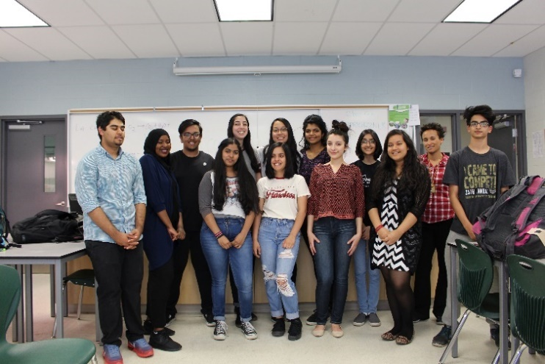
SWI: Castlebrooke S.S
Body Image
Video Campaign+ Social experiment
Reach: 1500 students

Slide 11
Using Data to Drive Social Change
Why is data an effective tool to use when planning for social change?

Slide 12
Why use data?
Data can show us a trend, a story, something we may not see or experience firsthand.
Data captures the voices of more than just a few, giving us a broader snapshot of an environment or of a population.
Decisions made in the world are often made based on evidence, especially in areas of law and social policy. You need data to show why an issue is important and deserves resources and attention.

Slide 13
Limitations of data
Participants don’t always respond honestly to questions (because of real or perceived risks such as fear of retaliation, lack of confidentiality, etc.)
Questions may not be accessible (i.e. language barriers, learning disabilities, etc.)
Data doesn’t always capture every lived experience

Slide 14
School Climate data
Insert your local school data results here (e.g. Safe Schools Survey, health and well-being survey, etc.)

Slide 15
SWI Brainstorm
What are some challenges or gaps we see in our school climate?

Slide 16
SWI Brainstorm.
“I hear “that’s so gay” all the time in our hallways. Maybe we can do an awareness campaign on homophobic language.”
Questions to consider:
Who do we want to be an ally to?
What challenge would we like to address?
What change would we like to see in this school?
Featured in the Access to Media Education Society’s “Racism for Reel” resource guide (2002), this activity was invented by Enid Lee and developed by members of the DorisMarshall Institute in Toronto. It is from the book Becoming an Ally: Breaking the Cycle of Oppression by Anne Bishop. (Halifax NS: Fernwood, 1994.)

Slide 17
See Different in Action → At your school!
School Wide Initiative | What? What do we want to do about it? (See possible Actions→)
 | How? How are we going to accomplish our goal? How are we going to execute our plan?
ACTIONS
Change behaviour
Change attitude
Affect school morale
Raise Awareness
Empower
Shock
Inform
Informative
Survey/poll
Research
Presentations
Human Library
Campaign
Webpage
Audiovisual
Exhibition
Performance
Work of art
Song
Video
Webpage
Experiential
Role Play
Scavenger Hunt
Cultural celebration
Competition

Slide 18
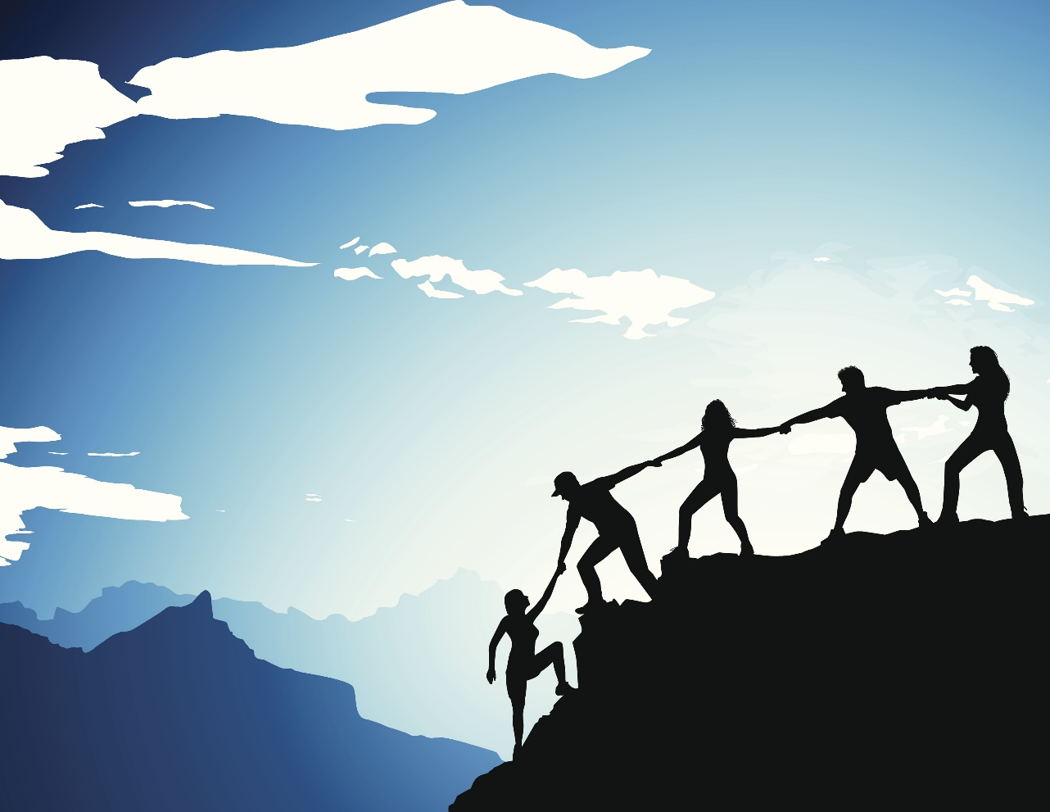
SWI Teams
Marketing
Research
Logistics/ Admin
Design

