Slide 1
Workshop 4: Navigating the Conflict Zone and Becoming an Ally

Slide 2
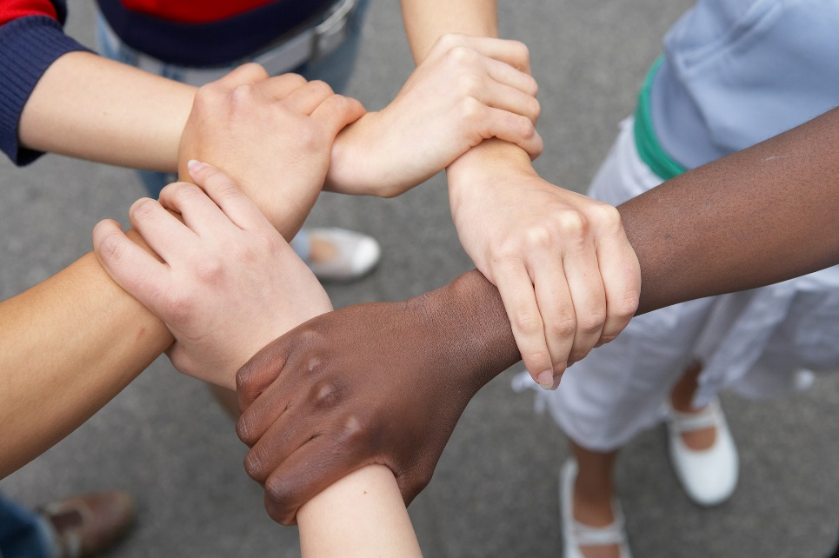
Community Commitments
Listening
Right to Pass
Appreciation
Confidentiality
Speak for Yourself
Right to “Ouch”

Slide 3
Key Points from Workshop 3
We all have filters that inform our worldview.
The cycle of prejudice and discrimination can result from stereotypes/bias.
We can work to prevent the creation of new biases and limit the impacts of our current biases.

Slide 4
Please
Step
Forward

Slide 5
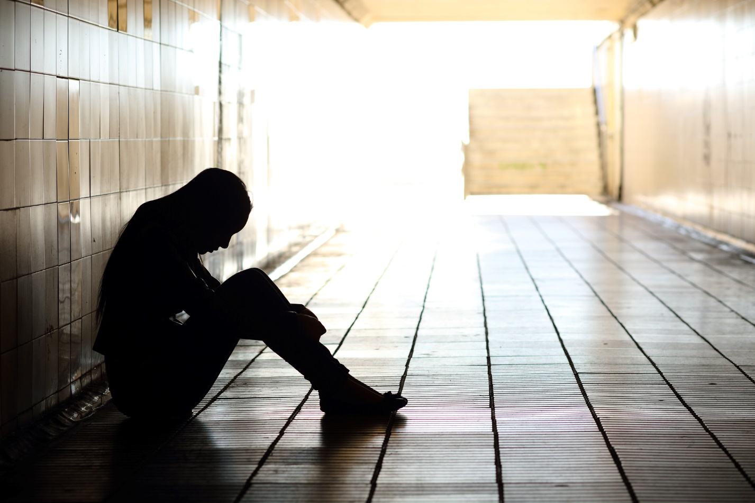
Conflict Styles Part 1: Spectrum of conflict

Slide 6
Conflict Styles Part 2: Approaches to conflict
Compromisers
Problem Solvers
Competitors
Accommodators
Avoiders
Adapted from United States Institute of Peace. (2014). Global Peacebuilding Center.
Retrieved from http://www.buildingpeace.org/act-build-peace/learn/conflict-styles

Slide 7
Cross-Cultural Communications Kahoot Quiz
How much do you know about cross-cultural communication?
Text in to play!

Slide 8
Spotting an Ally Part 1: Defining Ally
Notes:
https://www.youtube.com/watch?v=_dg86g-QlM0

Slide 9
Spotting an Ally Part 1: Defining Ally
An ally is any person who supports, empowers, or stands up for another person or a group of people.

Slide 10
Part 2: Spotting an Ally

Slide 11
Spotting an ally: Scenario 1
Jack, a college educated man, works at a community centre in a low-income neighbourhood. He trains neighborhood people to lead community meetings, rather than leading the meetings himself.
Is Jack an ally? (yes or no?)
If so, to whom? (which equity-seeking group?)
If not, why not?
Which strategy is he using or could he use? (Refer to handout)
Notes:
You are invited to turn this into a handout if needed.
Scenario taken from: http://ctb.ku.edu/en/table-of-contents/culture/cultural-competence/be-an-ally/main

Slide 12
Spotting an ally: Scenario 2
Janine’s friend, Kyle, frequently says ‘That’s so gay’ to express his dislike for something. Janine knows this language is offensive but she doesn’t stop him from saying it because she knows he only feels comfortable using this expression with her. Janine is confident that he doesn’t use this expression with people he knows are gay so she doesn’t bother confronting him about the use of the expression.
Is Janine being an ally? (yes or no?)
If so, to whom? (which equity-seeking group?)
If not, why not?
Which strategy is she using or could she use? (Refer to handout)
Notes:
You are invited to turn this into a handout if needed.
Scenario taken from: http://ctb.ku.edu/en/table-of-contents/culture/cultural-competence/be-an-ally/main

Slide 13
Spotting an ally: Scenario 3
Mark complains that university/college admissions are tougher now than they were during his parents’ time. He says that immigrants are making higher education more competitive by ‘taking all the spots’. He concludes that immigrants are making it harder for people who have lived here for generations to go to post-secondary unless they have the top grades.
Maria tells Mark to stop complaining and just accept this new reality: life is more competitive now with immigrants but this is not the fault of immigrants. She claims it is the government’s fault for accepting so many even though there are no jobs for them. But, she says, you can’t blame immigrants for wanting to go into higher education.
Is Maria being an ally? (yes or no?)
If so, to whom? (which equity-seeking group?)
If not, why not?
Which strategy is she using or could she use? (Refer to handout)
Notes:
You are invited to turn this into a handout if needed.
Scenario taken from: http://ctb.ku.edu/en/table-of-contents/culture/cultural-competence/be-an-ally/main

Slide 14
Extending allyship to our school
Which groups are not heard?
Who needs support?

Slide 15
Key Concepts
There are diverse approaches to conflict.
Cross-cultural communication and bridges to communication are key skills in inclusive leadership.
Allyship is an effective way of supporting those involved in exclusionary conflict and empowering others.

